Slide 1
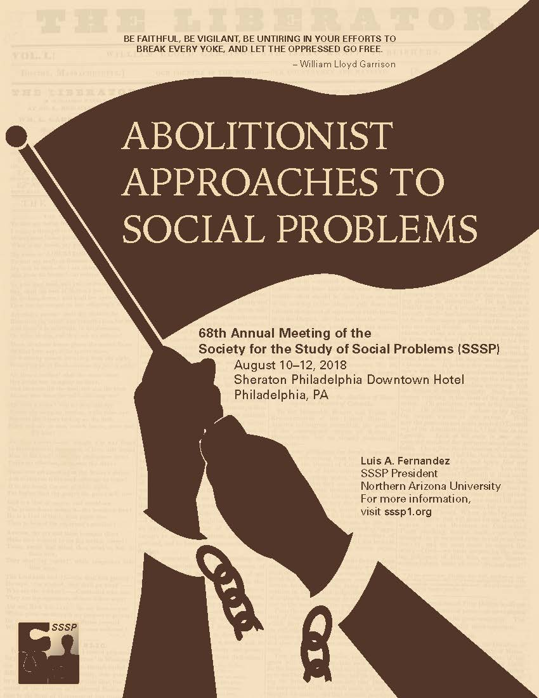

Slide 2


Society for the Study of Social Problems
2018 Student Paper
Competition Winners
Presented by
Dr. Bhoomi K. Thakore
Chairperson, Council of the Divisions
and
Dr. Kristen M. Budd
Chairperson-Elect, Council of the Divisions

Slide 3
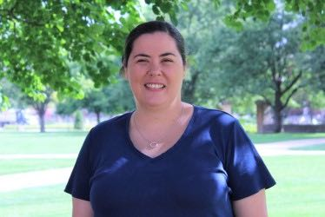
Community Research and
Development Division
Paper Award Winning Title
“The Contemporary Defended Neighborhood: Maintaining Stability in a Diverse Community”
Joy Kadowaki
Purdue University

Slide 4
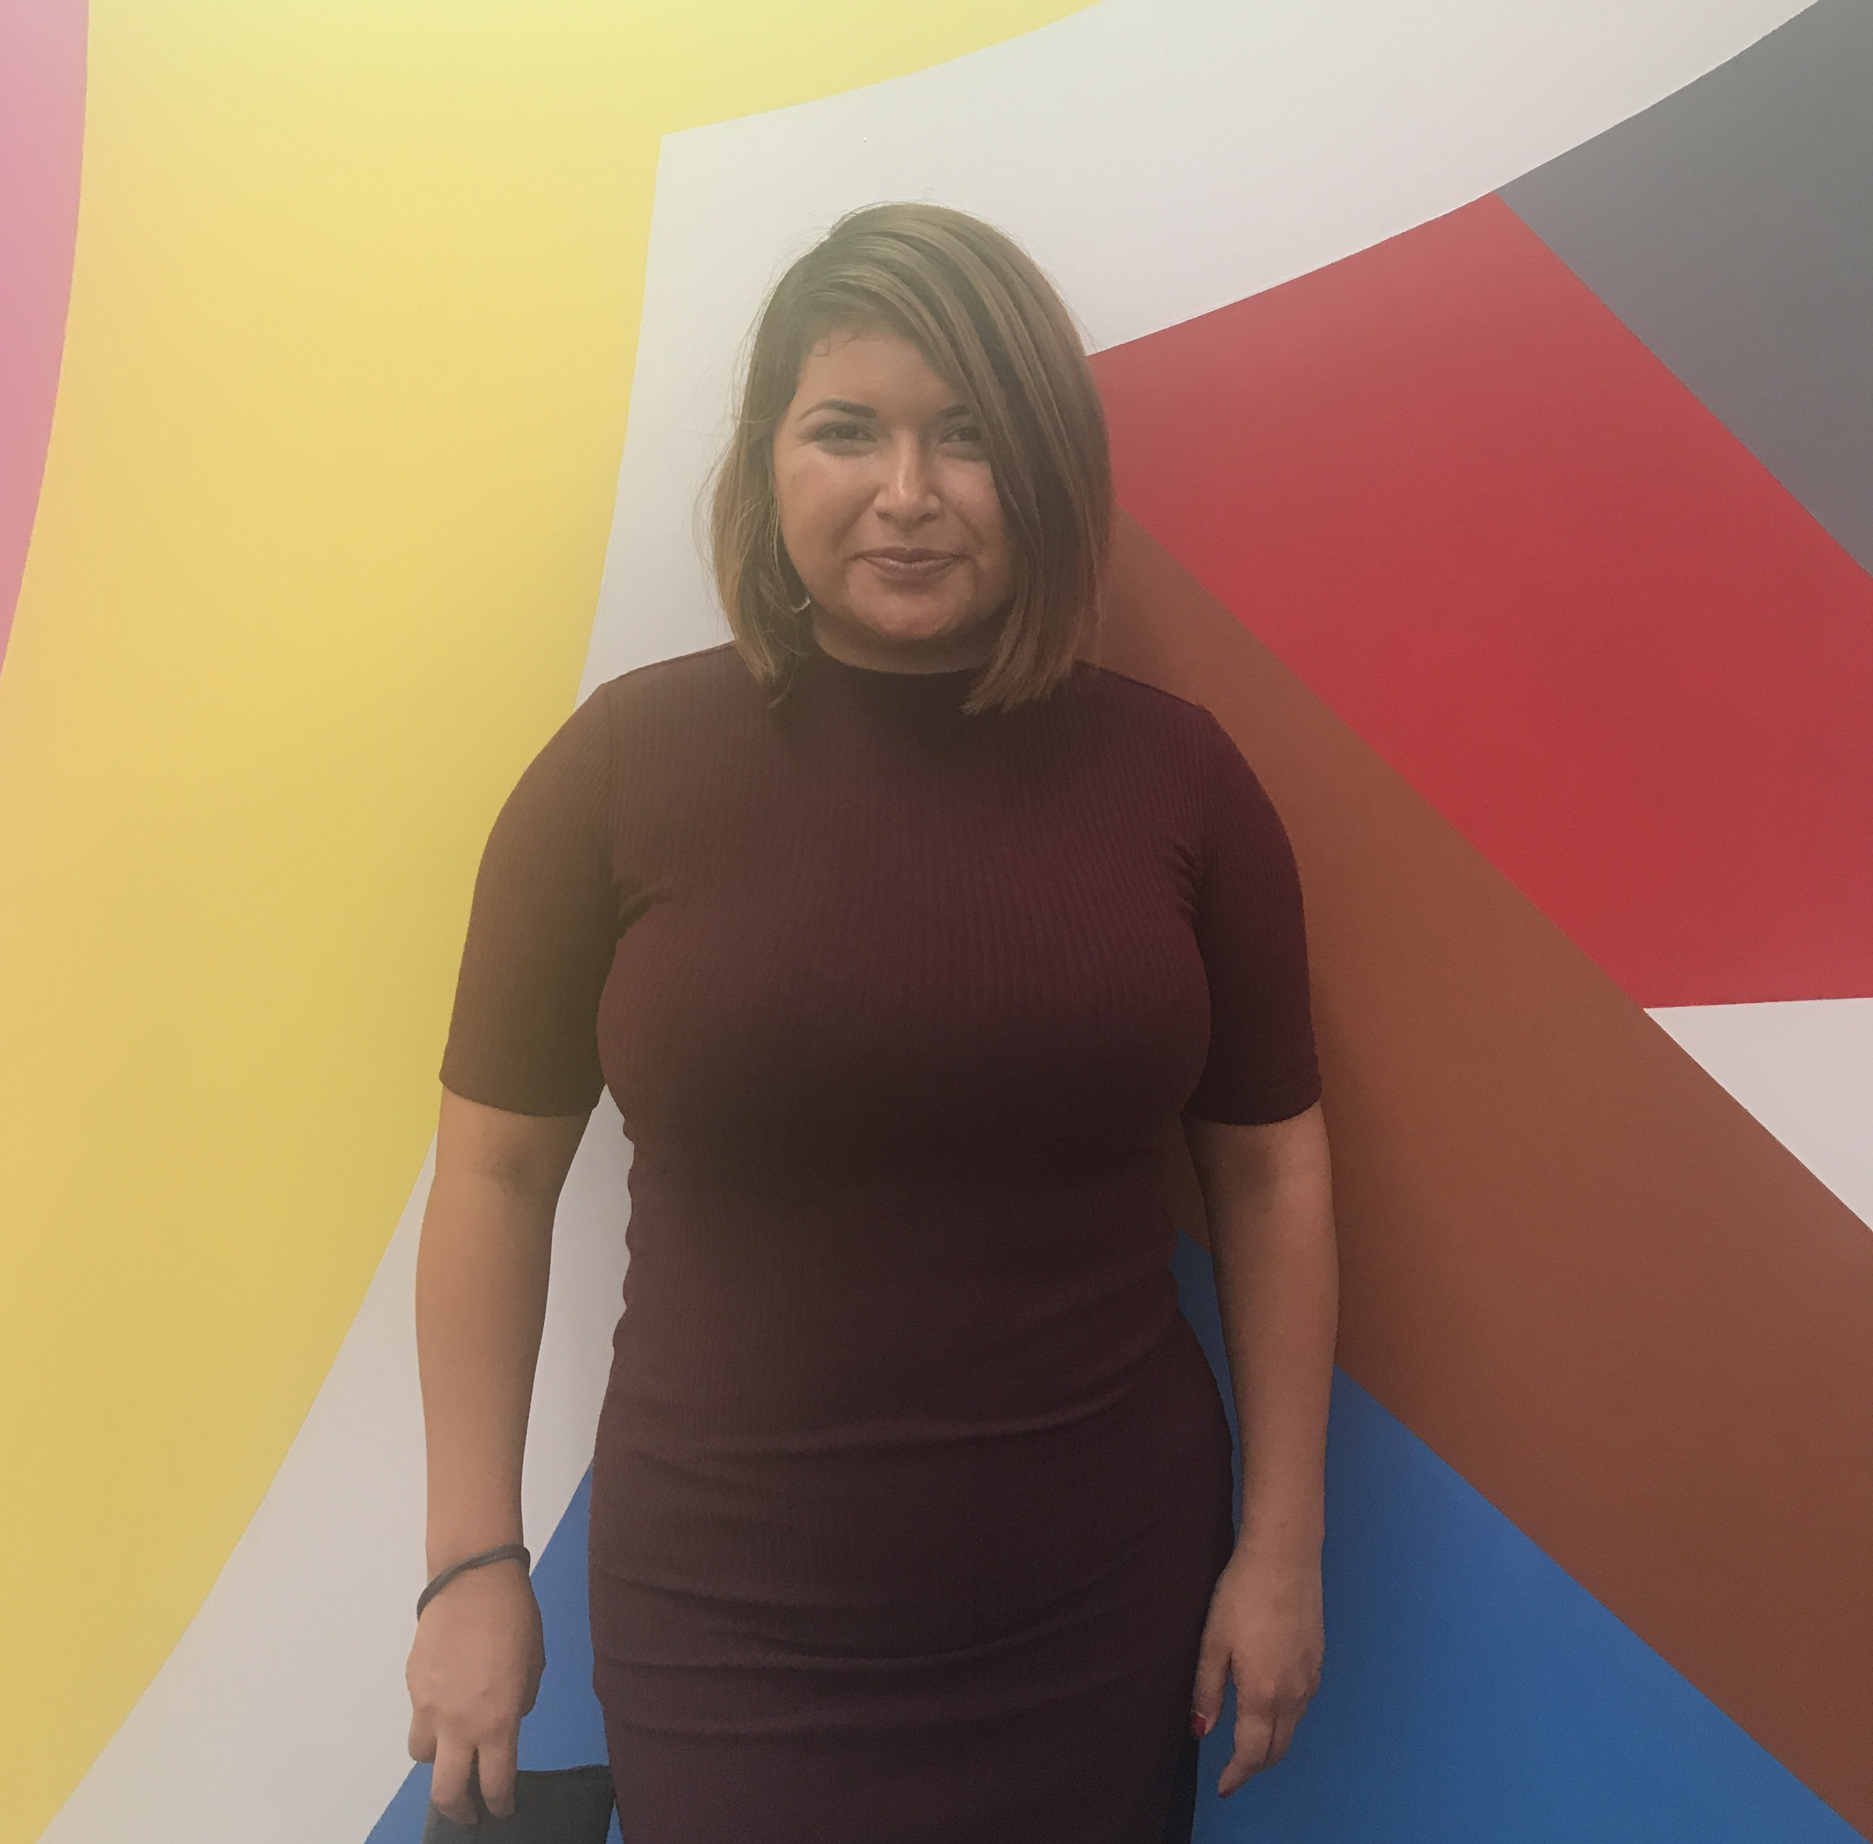
Conflict, Social Action,
and Change Division
Paper Award Winning Title
“Displacing Natives: Social Movement Influence over Mascot Change
at Colleges and Universities”
Noemi Linares-Ramirez
University of California, Irvine

Slide 5
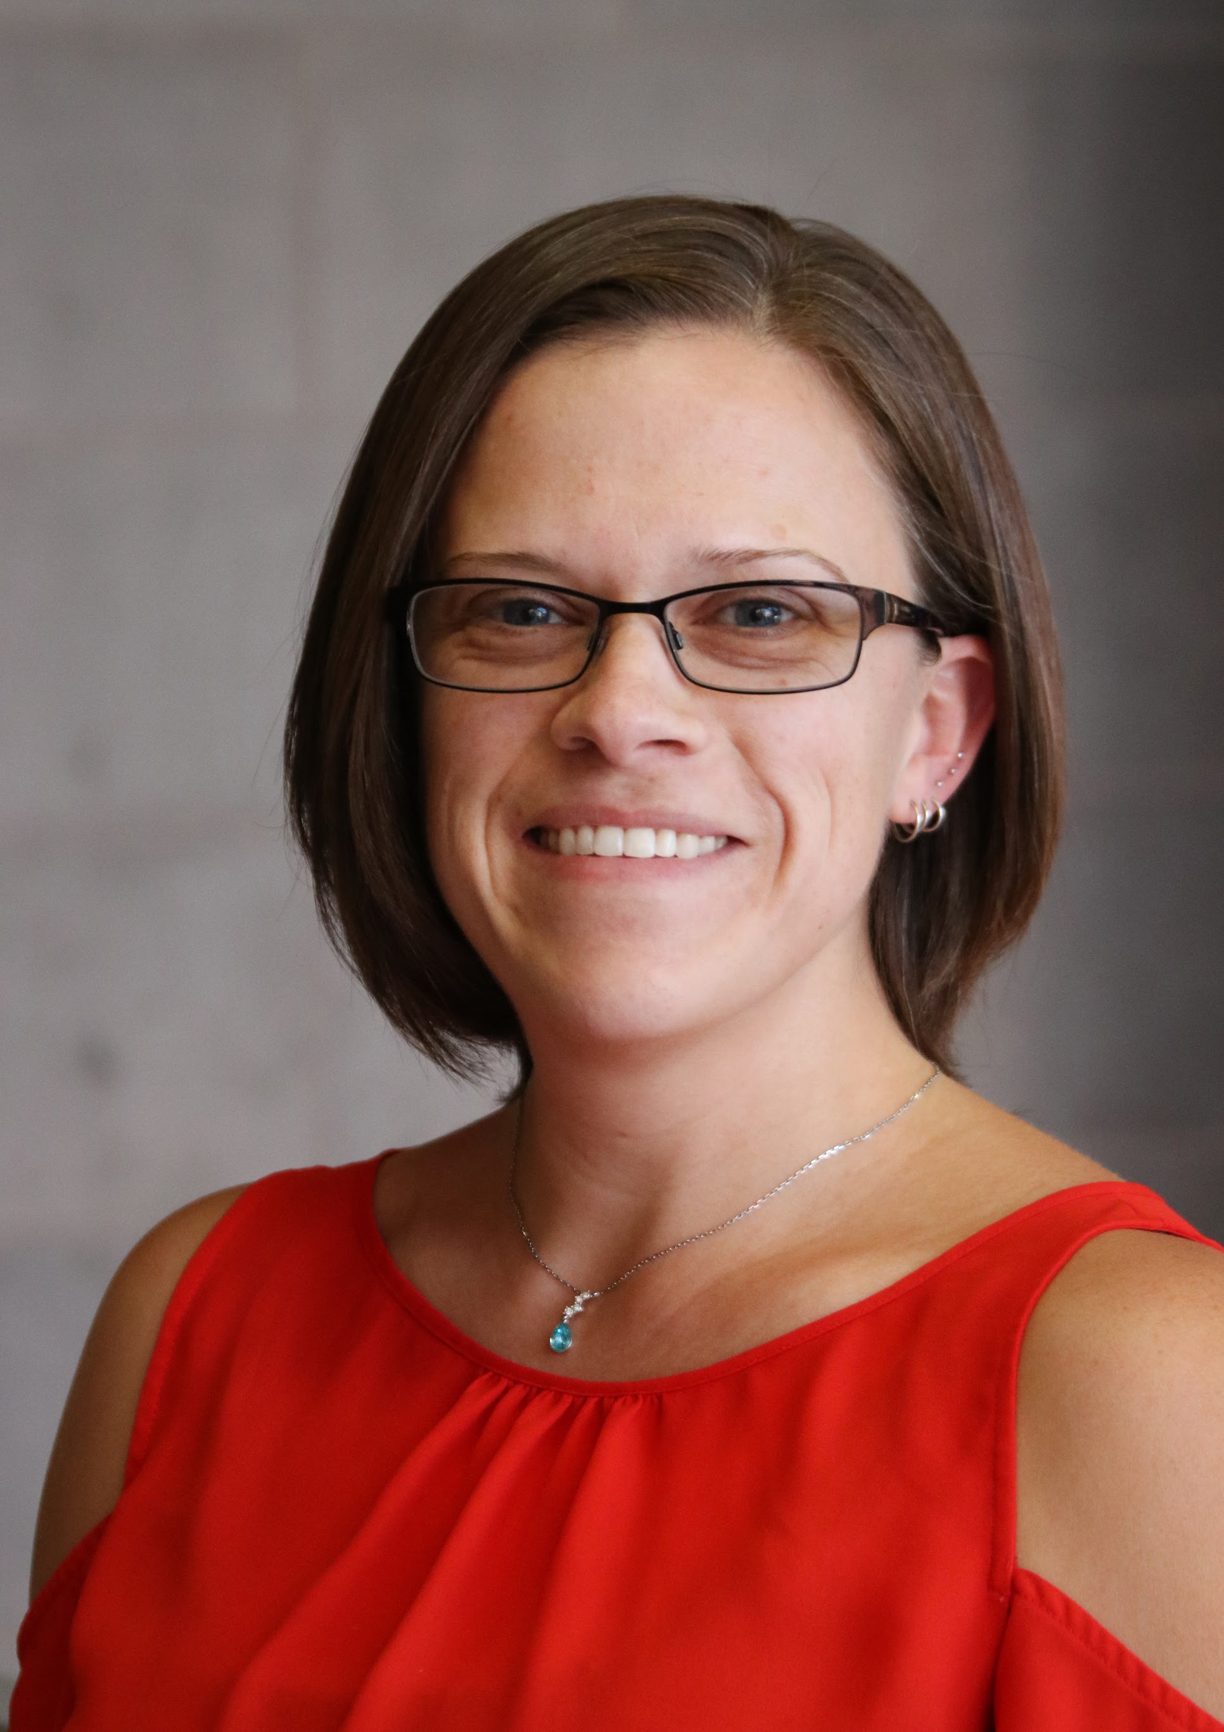
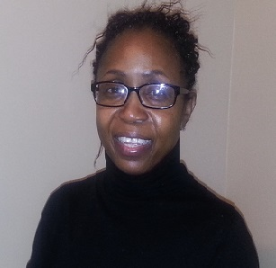
Crime and Juvenile
Delinquency Division
Paper Award Winning Title
“Luck of the Draw: Exploring the Effects of Parole Board Composition upon Parole Release Decisions”
Kristen L. Hourigan
Allison Houston
California State University, Los Angeles
University at Albany, SUNY

Slide 6
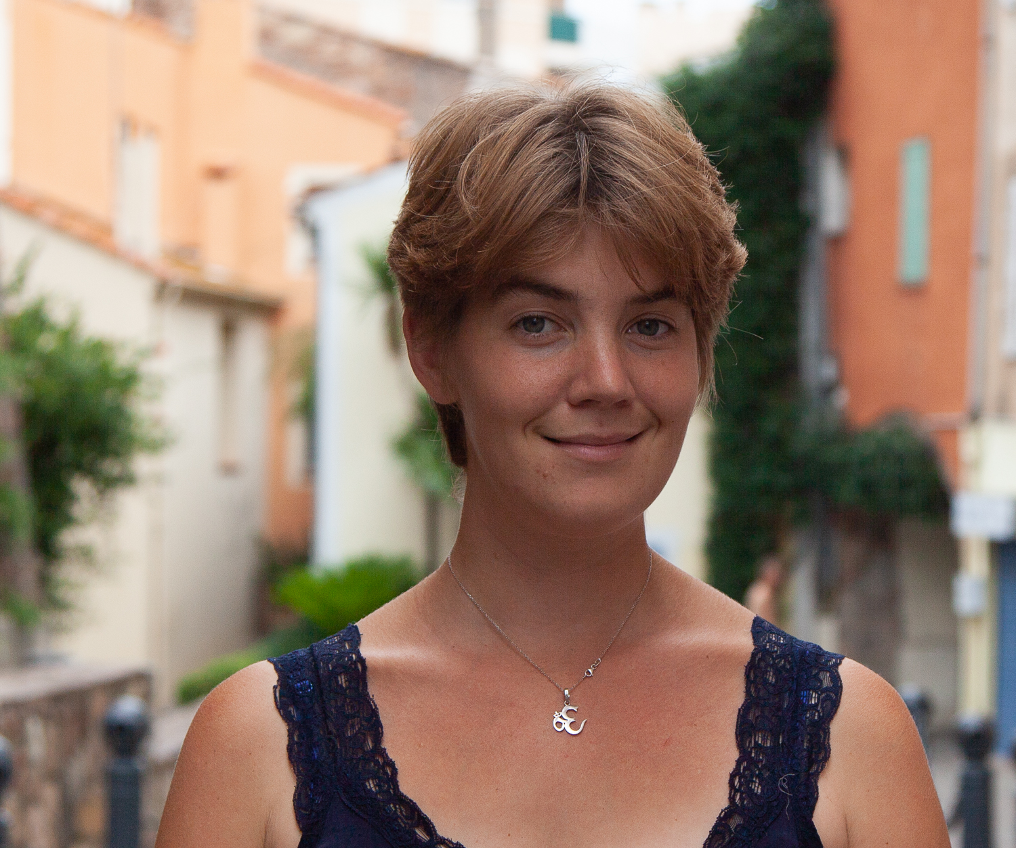
Disability Division
Paper Award Winning Title
“Tell me your Story – Quota Compliance and the Pitfalls of new Recruitment Tools”
Lisa Danielle Buchter
Northwestern University, CSO (Sciences Po)

Slide 7
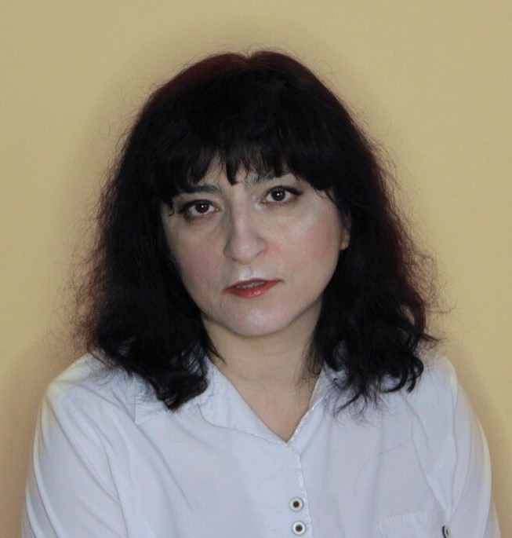
Drinking and Drugs Division
Bruce D. Johnson Paper Award Winning Title
“Multiple Victimizations and Overdose among Women in a Harm Reduction Program”
Janna Ataiants
Drexel University

Slide 8
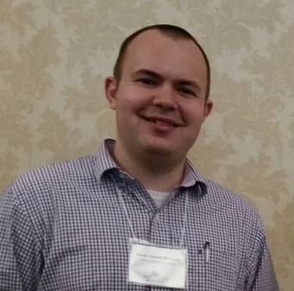
Educational Problems Division
Paper Award Winning Title
“The Intensity of College Preparation and Socioeconomic Background:
A Mechanism for Equal Access?”
Kevin McElrath
Stony Brook University

Slide 9
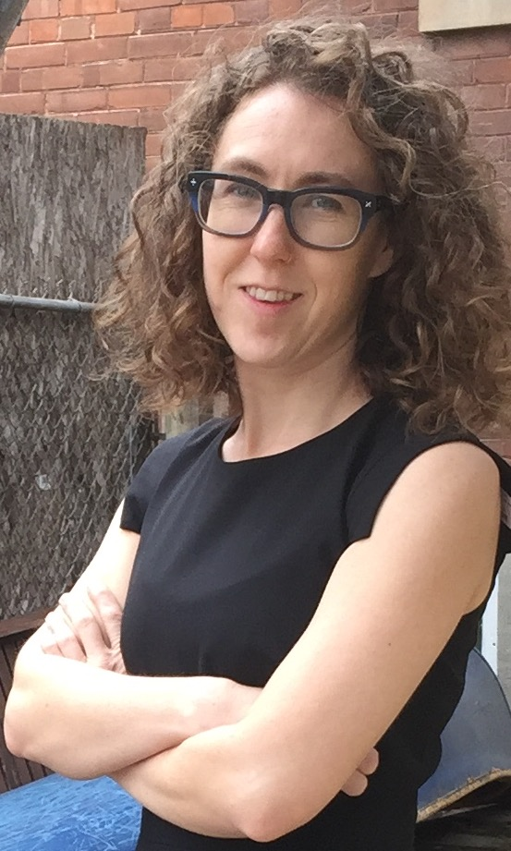
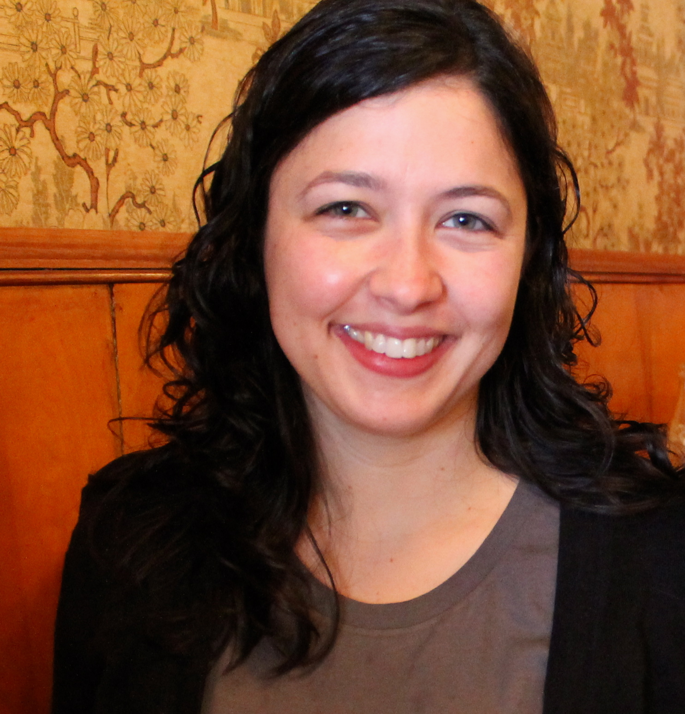
Environment and Technology Division
Brent K. Marshall Paper Award Winning Title
“Contradictions of Solidarity: Whiteness, Settler Coloniality, and the Mainstream Environmental Movement”
Joe Curnow
Anjali Helferty
University of Toronto

Slide 10
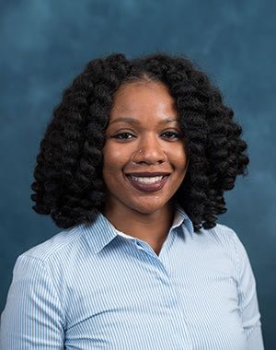
Family Division
Paper Award Winning Title
“Extended Family Households among U.S. Children:
Differences by Race/Ethnicity and SES”
Christina Cross
University of Michigan

Slide 11

Global Division/Critical Sociology
Paper Award Winning Title
“Making Cold War Migrants: Vietnamese in Divided Germany”
Phi Hong Su
University of California, Los Angeles

Slide 12
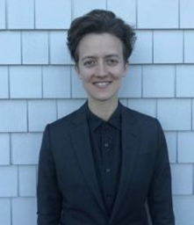
Health, Health Policy,
and Health Services Division
Paper Award Winning Title
“Embodied Disruption: ‘Sorting Out’ Gender and Nonconformity in the Doctor’s Office”
Emily Allen Paine
University of Texas at Austin

Slide 13

Institutional Ethnography Division
George W. Smith Paper Award Winning Title
“The ‘Equity Work’ of the Activist Educator: Critical Re-imagining of Schools”
Alison Fisher
York University

Slide 14
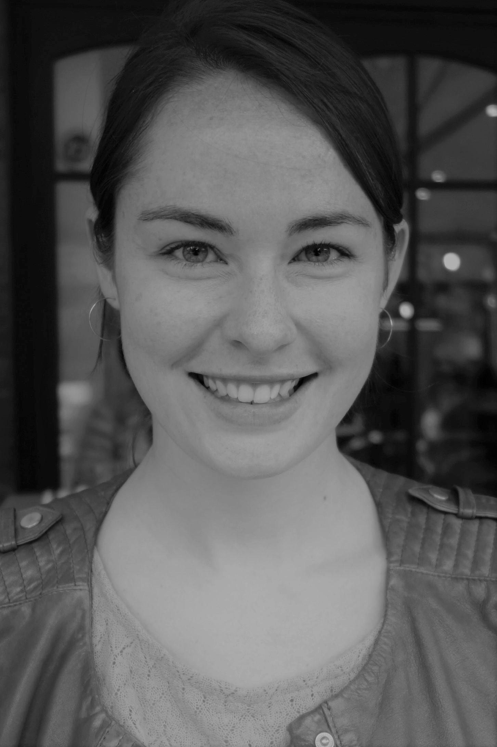
Labor Studies Division
Harry Braverman Paper Award Winning Title
“Welfare Capitalism and the Corporate Construction of the Precarious Worker”
Amanda McMillan Lequieu
University of Wisconsin-Madison

Slide 15
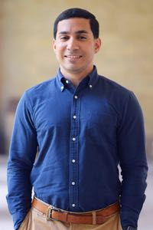
Law and Society Division
Alfred R. Lindesmith Paper Award Winning Title
“Ambiguity and Accountability: The Expansion of Legal Fines and Fees in Texas, 1985-2015”
Kevin Dahaghi
University of Texas at Austin

Slide 16
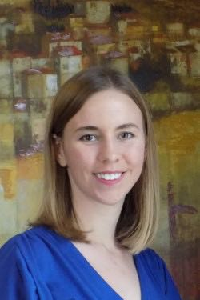
Poverty, Class, and Inequality Division
Paper Award Winning Title
“Economic Exchange and Relational Work within Doubled-up Households”
Hope Harvey
Harvard University

Slide 17
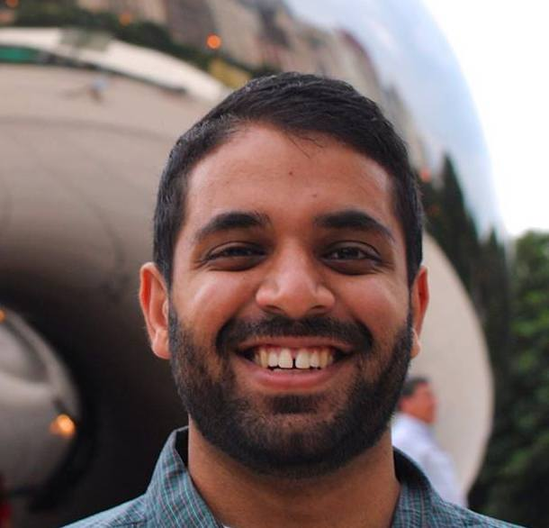
Racial and Ethnic Minorities Division
Paper Award Winning Title
“Policing to Segregate: Sketching the Contours of an Eviction Regime
in Suburban Los Angeles”
Rahim Kurwa
University of California, Los Angeles

Slide 18
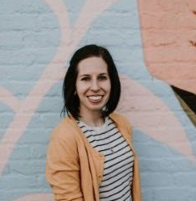
Sexual Behavior, Politics,
and Communities Division
Paper Award Winning Title
“Navigating Reproductive Inequalities: Emotion Work among Lesbian Couples during the Transition to Parenthood”
Sierra Holland
University of Florida

Slide 19
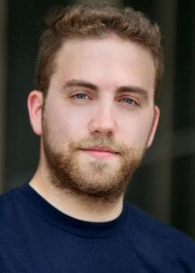
Social Problems Theory Division
Paper Award Winning Title
“Streets of Pity: Urban Panhandling and the Valorization of Misfortune”
Joseph Wallerstein
Harvard University

Slide 20
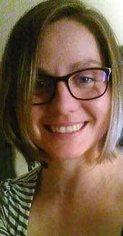
Society and Mental Health Division
Paper Award Winning Title
“Exiters of Religious Fundamentalism: Reconstruction of Social Relationships
and Support Related to Mental Well-being”
Andreea Nica
Portland State University

Slide 21

Sociology and Social Welfare Division
Paper Award Winning Title
"Hostile Architecture Aimed at People Experiencing Homelessness in Boston, Massachusetts: A Spatial Analysis”
Caitlin A. Carey
University of Massachusetts Boston

Slide 22
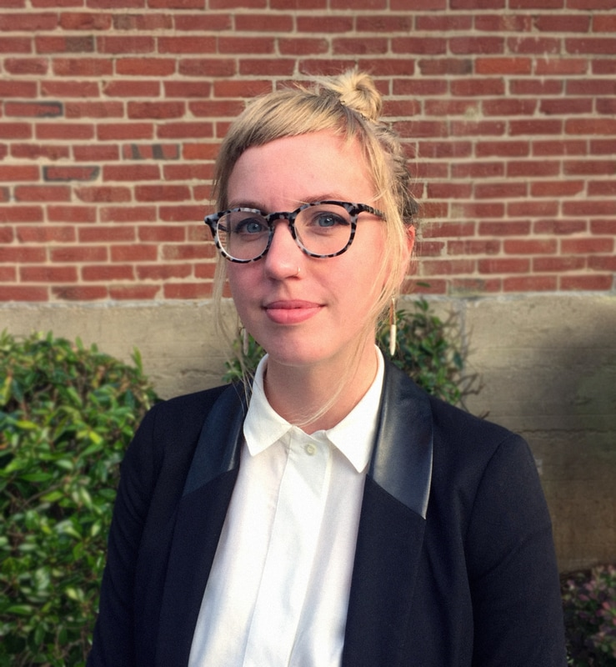
Sport, Leisure, and the Body Division
Paper Award Winning Title
“Techno-physical Feminism: Surveillance, Anti-rape Technology and Shifting Risk Paradigms”
Renee M. Shelby
Georgia Tech

Slide 23
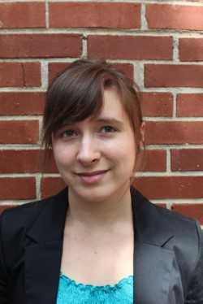
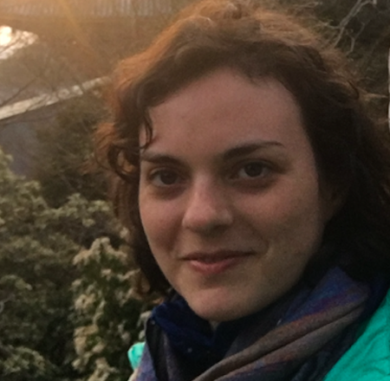
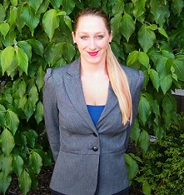
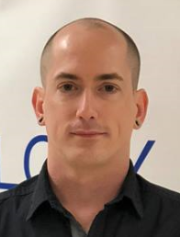
Teaching Social Problems Division
Paper Award Winning Title
“An Assessment of Learning: Understanding Empathy Change
in Sociology Undergraduates”
Ashley Rockwell
Leanna Greenwood
Penny Harvey
Chris Vidmar
Georgia State University

Slide 24
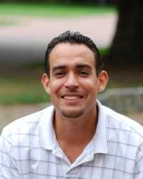
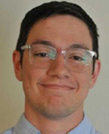
Youth, Aging, and
the Life Course Division
Paper Award Winning Title
“From the Hood to the Home: Masculinity Reformation of Chicago Street Gang Members”
John Leverso
Chris Hess
University of Washington

Slide 25

Society for the Study of Social Problems
2018 Racial/Ethnic Minority
Graduate Fellowship
Presented by
Dr. Ana Muñiz
Committee Chair

Slide 26
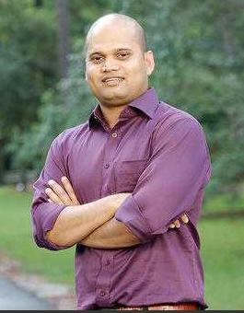
2018 Racial/Ethnic Minority
Graduate Fellowship Winner
Nikhil Deb
The University of Tennessee, Knoxville

Slide 27
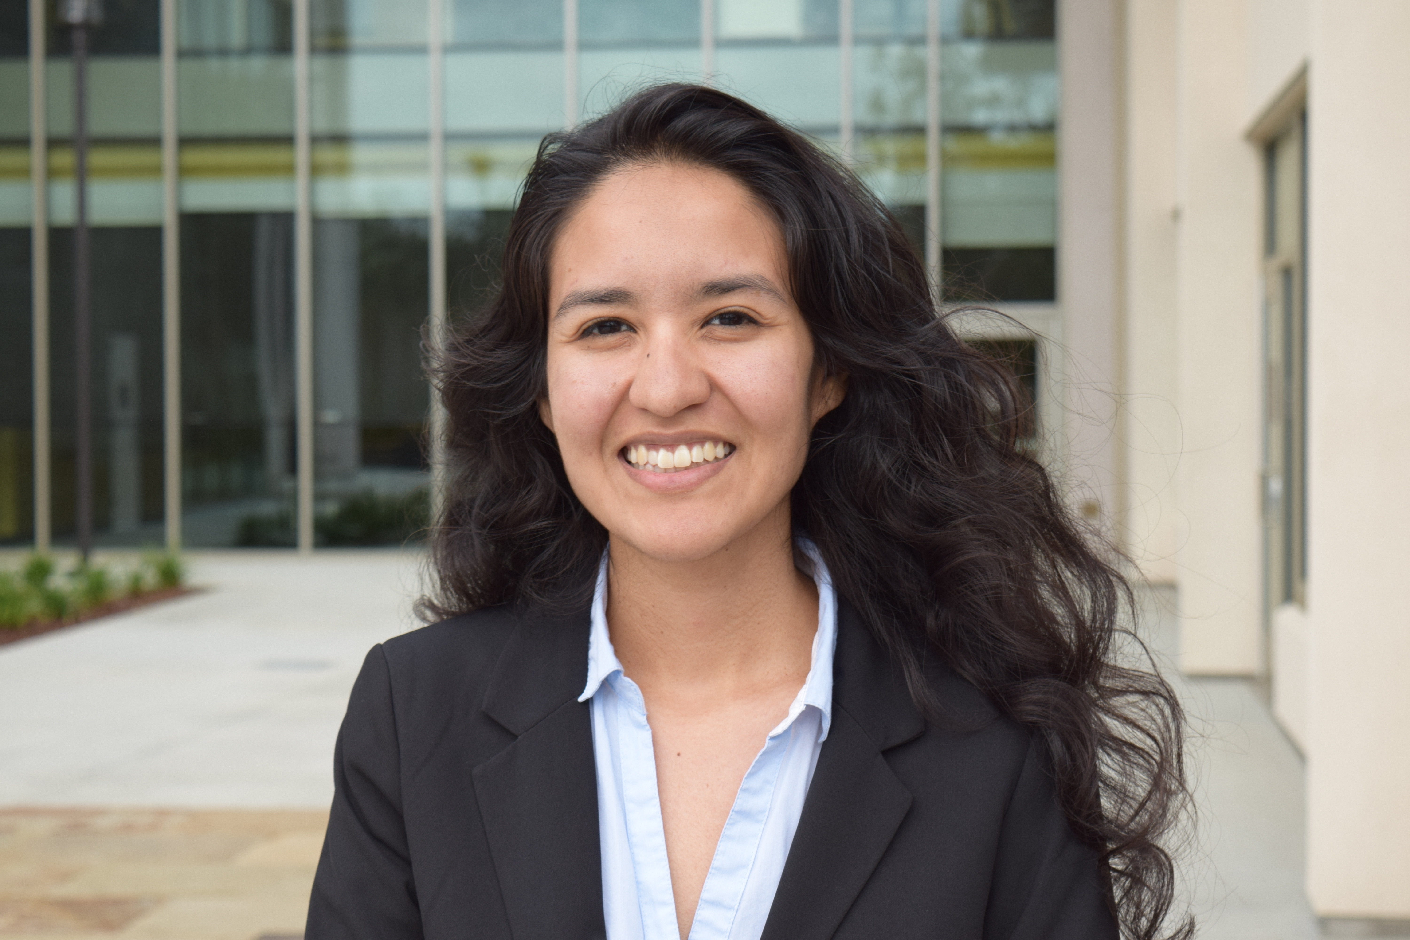
2018 Racial/Ethnic Minority
Graduate Fellowship Winner
Carolina Valdivia Ordorica
Harvard University

Slide 28
Society for the Study of Social Problems
2018 Arlene Kaplan Daniels
Paper Award
Presented by
Dr. Raymond J. Michalowski
Committee Chair

Slide 29
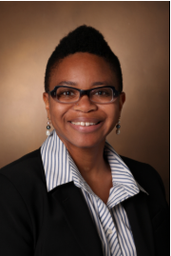
2018 Arlene Kaplan Daniels
Paper Award Winner
Dr. LaTonya J. Trotter
Vanderbilt University

Slide 30
Society for the Study of Social Problems
2018 Doris Wilkinson Faculty
Leadership Award
Presented by
Dr. Ruth Thompson-Miller
Committee Chair

Slide 31
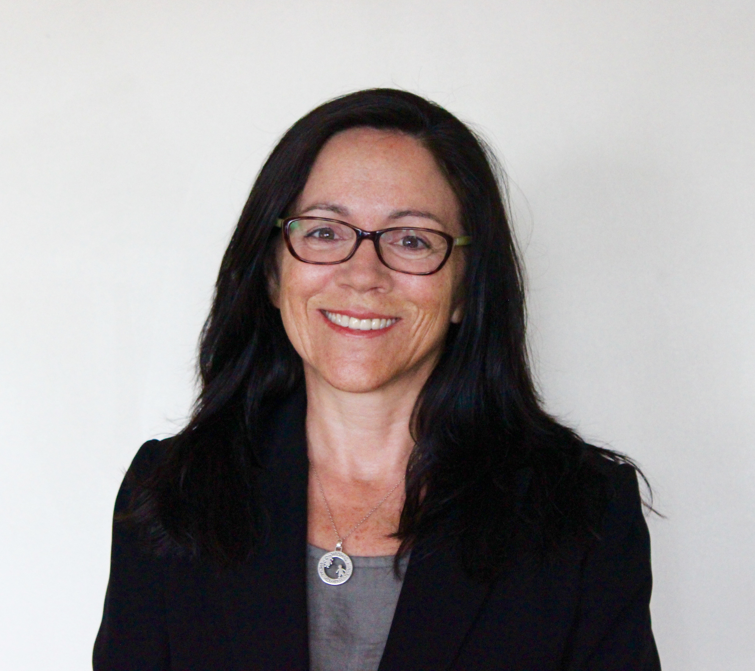
2018 Doris Wilkinson Faculty
Leadership Award Winner
Dr. Heather Dalmage
Roosevelt University

Slide 32
Society for the Study of Social Problems
2018 Joseph B. Gittler Award
Presented by
Dr. Anthony A. Peguero
Committee Chair

Slide 33
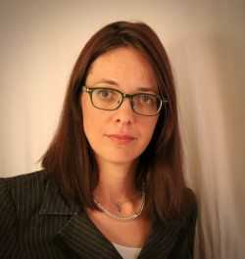
2018 Joseph B. Gittler
Award Winner
Dr. Hephzibah V. Strmic-Pawl
Manhattanville College

Slide 34
Society for the Study of Social Problems
2018 Kathleen S. Lowney Mentoring Award
Presented by
Dr. Lloyd Klein, Committee Member
on behalf of Dr. Jerome Krase, Committee Chair

Slide 35
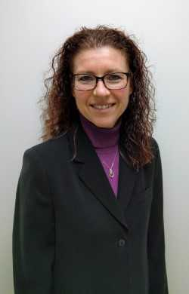
2018 Kathleen S. Lowney Mentoring
Award Winner
Dr. Shannon N. Davis
George Mason University

Slide 36
Society for the Study of Social Problems
2018 Thomas C. Hood
Social Action Award
Presented by
Dr. Kathleen A. Asbury
Committee Chair

Slide 37
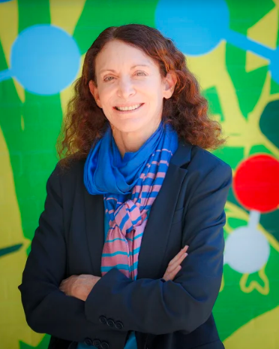

2018 Thomas C. Hood
Social Action Award Winner
Jane Golden is Executive Director of Mural Arts Philadelphia, overseeing its growth from a small city agency to the nation’s largest mural program and a model for community development around the globe. Under Golden’s direction, Mural Arts has created more than 4,000 landmark works of public art through innovative collaborations with community-based organizations, city agencies, nonprofits, schools, the private sector, and philanthropies.

Slide 38
Society for the Study of Social Problems
2018 Beth B. Hess
Memorial Scholarship
Presented by
President Luis A. Fernandez
on behalf of
Dr. Sarah K. Bruch, Committee Chair

Slide 39
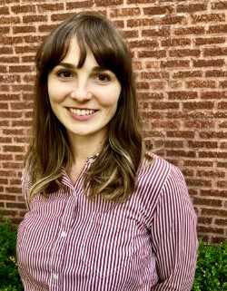
2018 Beth B. Hess Memorial Scholarship Honorable Mention
Katherine McCabe
University of Illinois at Chicago

Slide 40
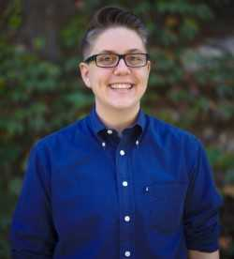
2018 Beth B. Hess Memorial Scholarship Winner
Melissa Osborne
The University of Chicago

Slide 41
Society for the Study of Social Problems
2018 Lee Founders Award
Presented by
Dr. Elroi J. Windsor
Committee Chair

Slide 42
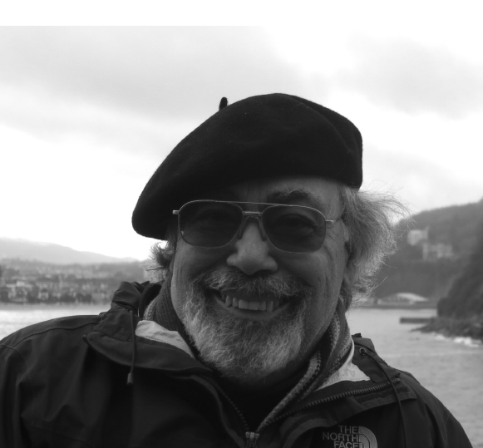
2018 Lee Founders
Award Winner
Dr. Raymond J. Michalowski
Northern Arizona University

Slide 43
Society for the Study of Social Problems
2017 C. Wright Mills Award
Presented by
Dr. George Lipsitz
Committee Chair

Slide 44
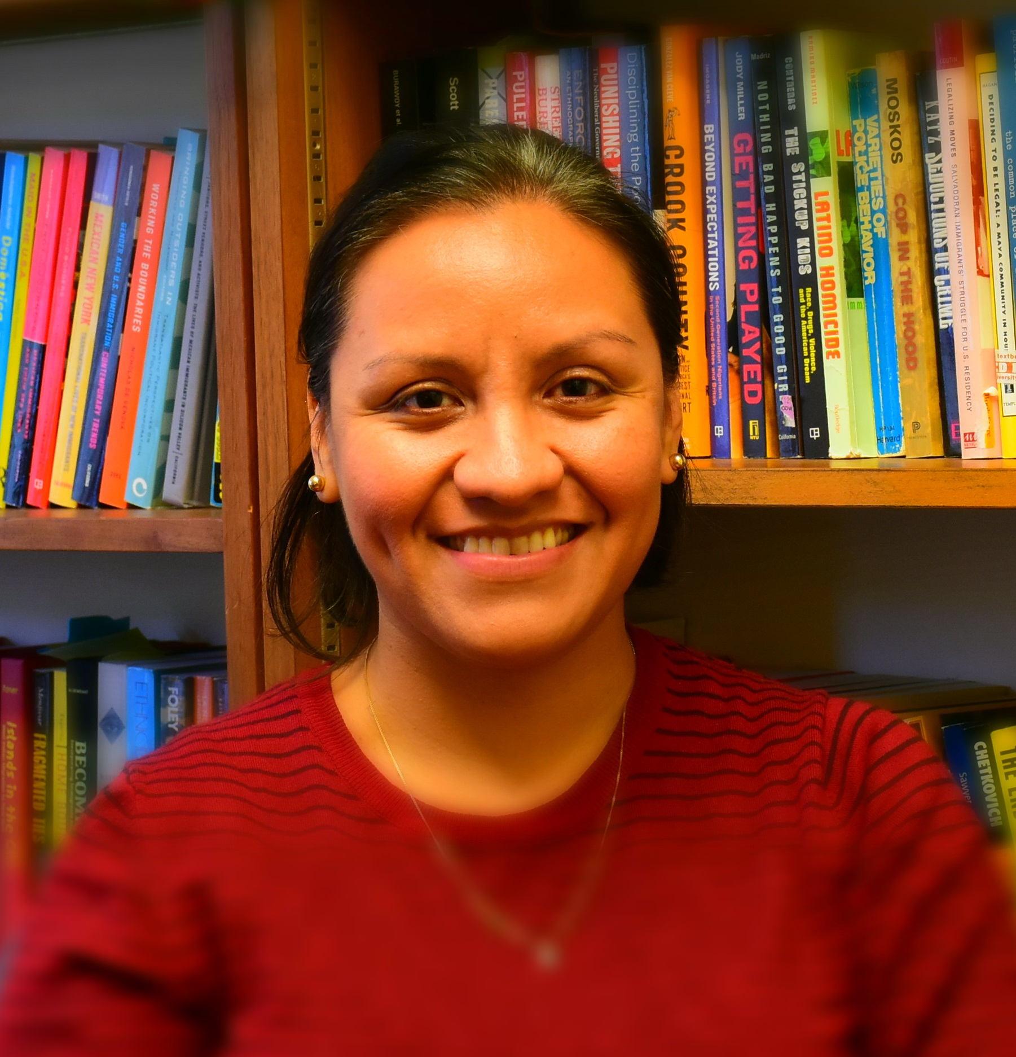

2017 C. Wright Mills Award Finalist
Finalist’s Book Title
Protect, Serve, and Deport: The Rise of Policing as Immigration Enforcement
Amada Armenta
University of Pennsylvania

Slide 45

2017 C. Wright Mills Award Finalist
Finalist’s Book Title
Big House on the Prairie: Rise of the Rural Ghetto and Prison Proliferation
John M. Eason
Texas A&M University

Slide 46
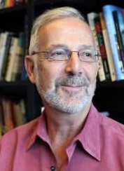
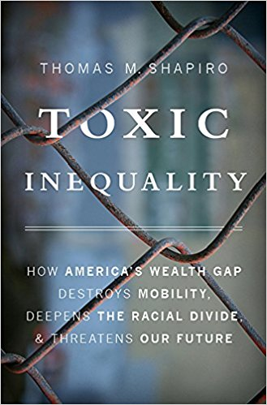
2017 C. Wright Mills Award Finalist
Finalist’s Book Title
Toxic Inequality: How America’s Wealth Gap Destroys Mobility, Deepens the Racial Divide
Thomas M. Shapiro
Brandeis University

Slide 47
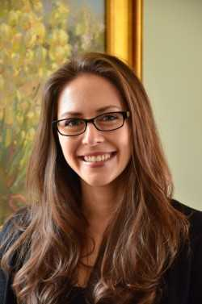

2017 C. Wright Mills Award Finalist
Finalist’s Book Title
The Zero Trimester: Pre-Pregnancy Care and the Politics of Reproductive Risk
Miranda R. Waggoner
Florida State University

Slide 48
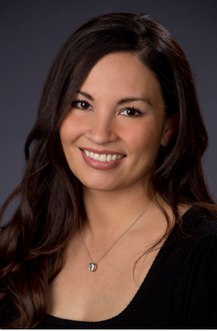

2017 C. Wright Mills Award Winner
Winning Book Title
Juárez Girls Rising: Transformative Education in Times of Dystopia
Claudia G. Cervantes-Soon
University of Texas - Austin

